Slide 2
Reference link
https://www.dj4e.com/assn/dj4e_hello.md?PHPSESSID=8c9d85fe9587e576177605402e6fed68

Slide 3
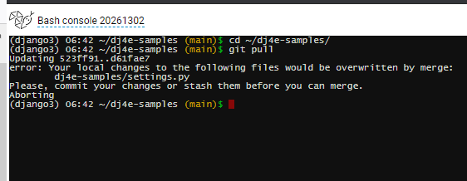
Get latest update

Slide 4
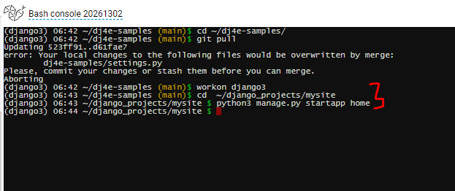
Create “home” page

Slide 5
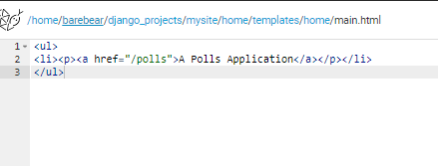
Create html file under home template

Slide 6
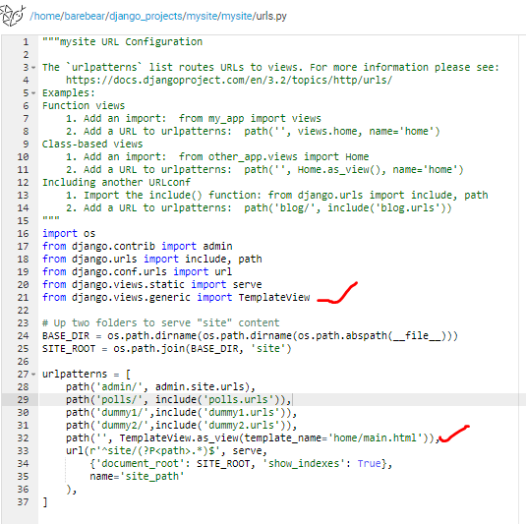
Edit the mysite/mysite/urls.py

Slide 7
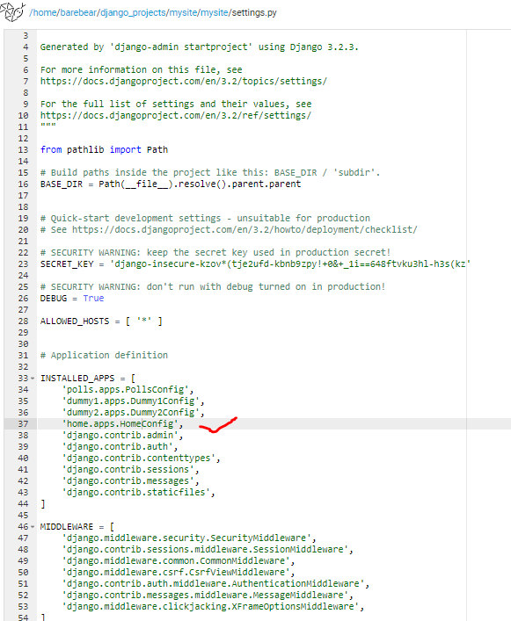
Update mysite/mysite/settings.py

Slide 8
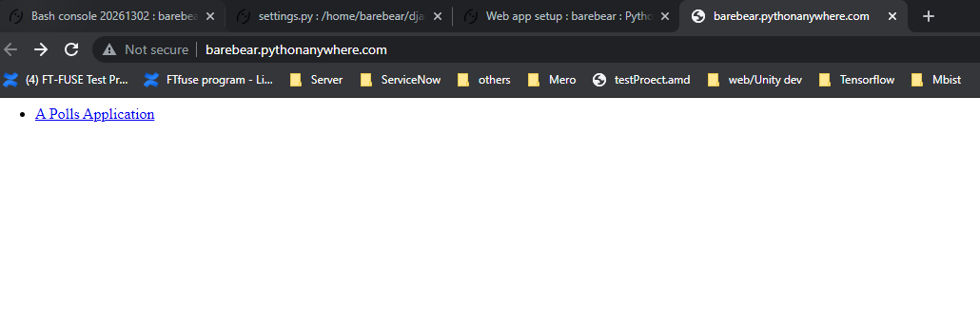

Slide 9
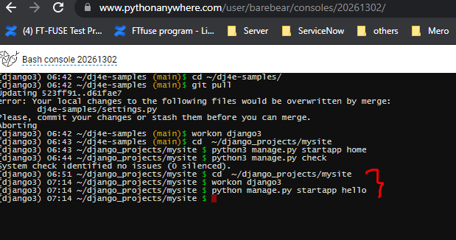
Create hello app
cd ~/django_projects/mysite
workon django3
python manage.py startapp hello

Slide 10
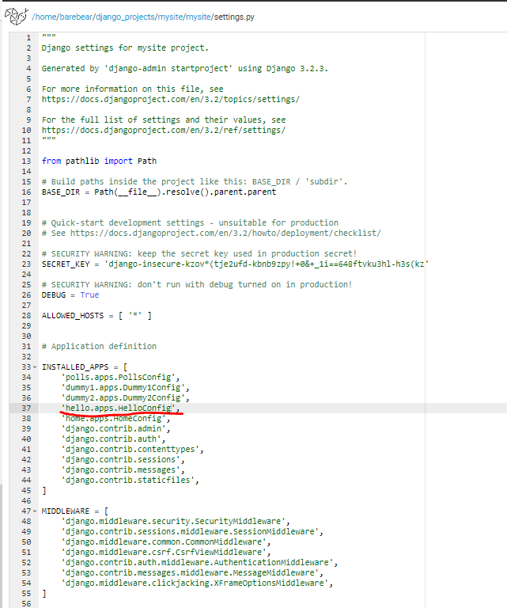
Update settings.py

Slide 11
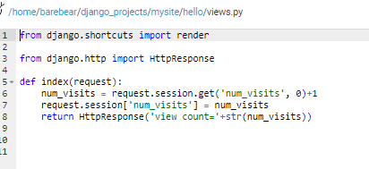
Update views.py

Slide 12
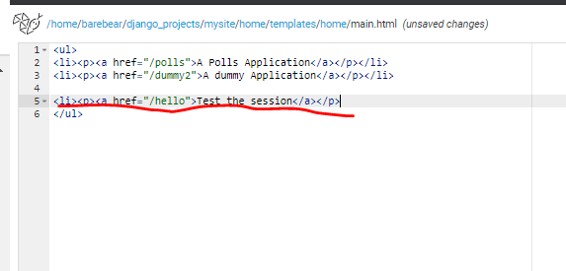
Add link to home/main.html

Slide 13
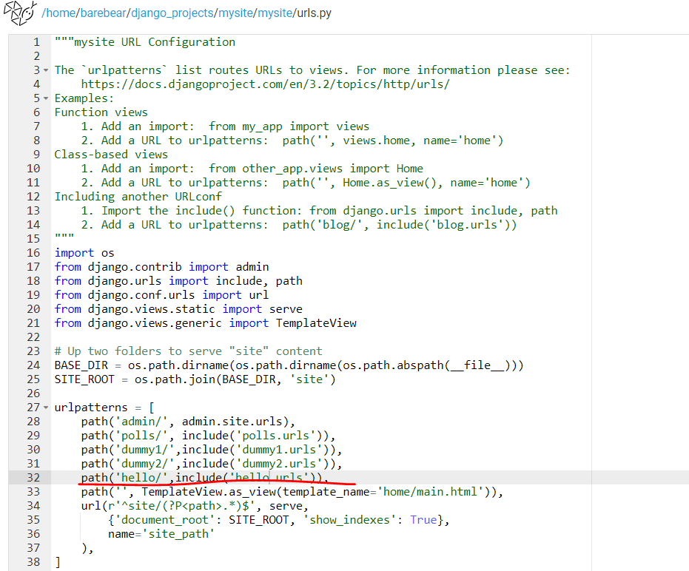
Update mysite/mysite/urls.py

